Slide 2
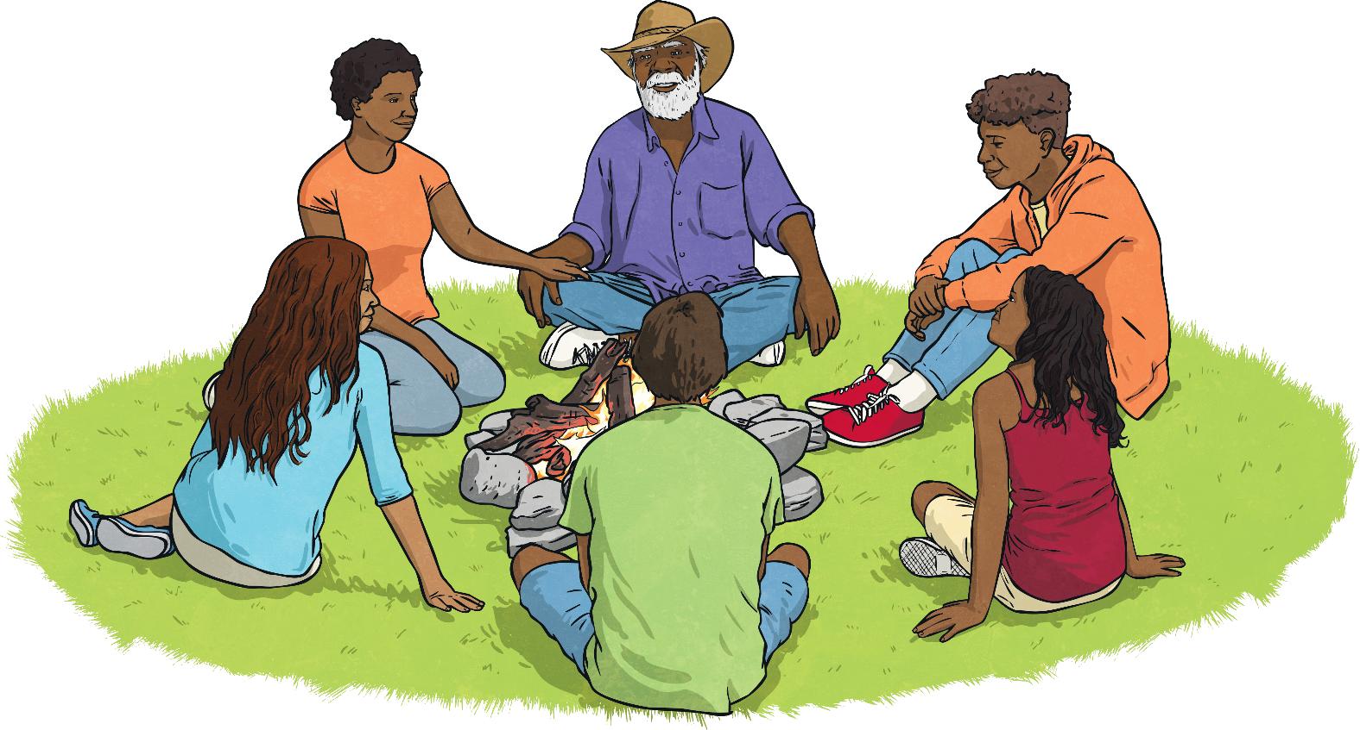
Long ago, Aboriginal and Torres Strait Islander people noticed that the stars in the night sky made patterns, twinkled, changed positions and could only be seen at certain times of the year. These groups of stars are called constellations. These constellations were given names and stories are still told about them today.
Did You Know?
Aboriginal astronomy focuses on the Milky Way and often includes the dark patches between stars.

Slide 3
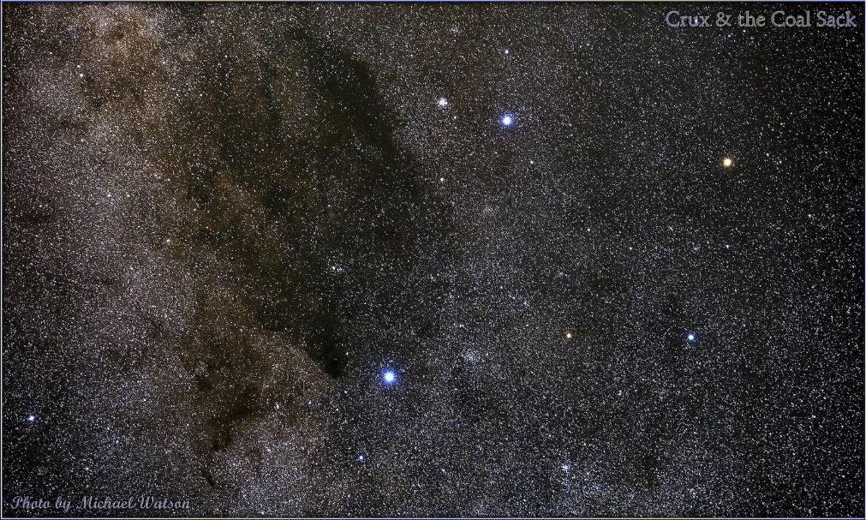
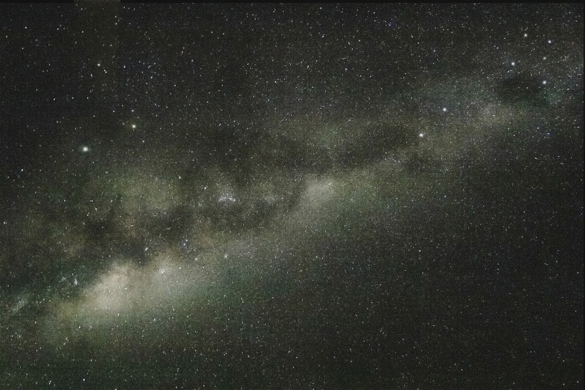
The Emu in the Sky is a constellation that is part of many Aboriginal stories. It can be seen by looking for the Milky Way and the Southern Cross constellation in the night sky.
The head of the emu is near the bottom left corner of the cross. Its neck is between the two pointer stars, and its body is made up of the dark patches in the Milky Way.
Southern Cross
Southern Cross
Emu
Photo courtesy (top) of Michael Watson (@flickr.com) - granted under creative commons licence
Photo courtesy (top) of Andrew Wallace (@flickr.com) - granted under creative commons licence

Slide 4
Direction
Stars help Aboriginal and Torres Strait Islander people by being position markers in the sky.
The Southern Cross constellation helps them with directions, like knowing which way is south.
Southern Cross
Photo courtesy (top) of Michael Watson (@flickr.com) - granted under creative commons licence

Slide 5
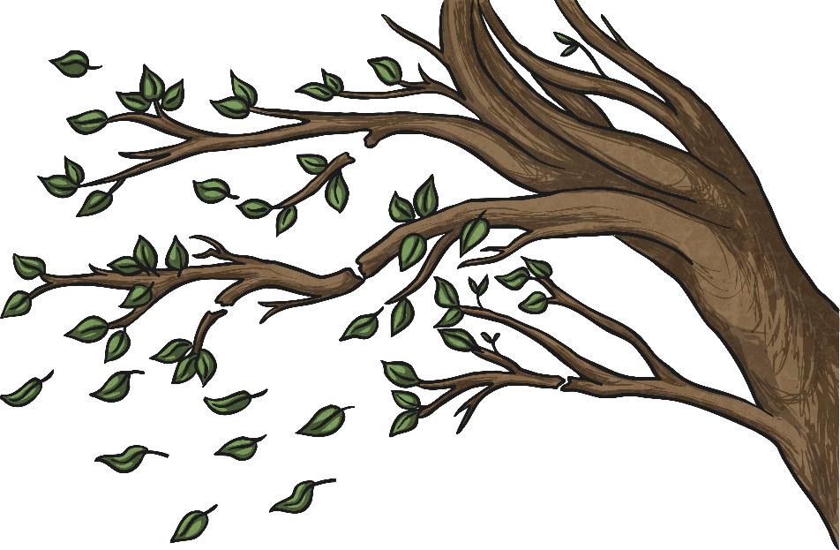
Predicting the Weather
The Torres Strait Islanders sing a song about the stars and the change of the seasons called ‘Uer Naskaisreda’ or ‘The Twinkling Stars’. This helps them understand that there are changes happening to the weather.
When the stars twinkle quickly, the islanders predicted that a wind will start to blow.
When the stars twinkle quickly, the islanders predict that a wind will start to blow.
The Torres Strait Islanders also look at the colour of the stars. If they are bright blue and twinkling, a storm is coming.

Slide 6
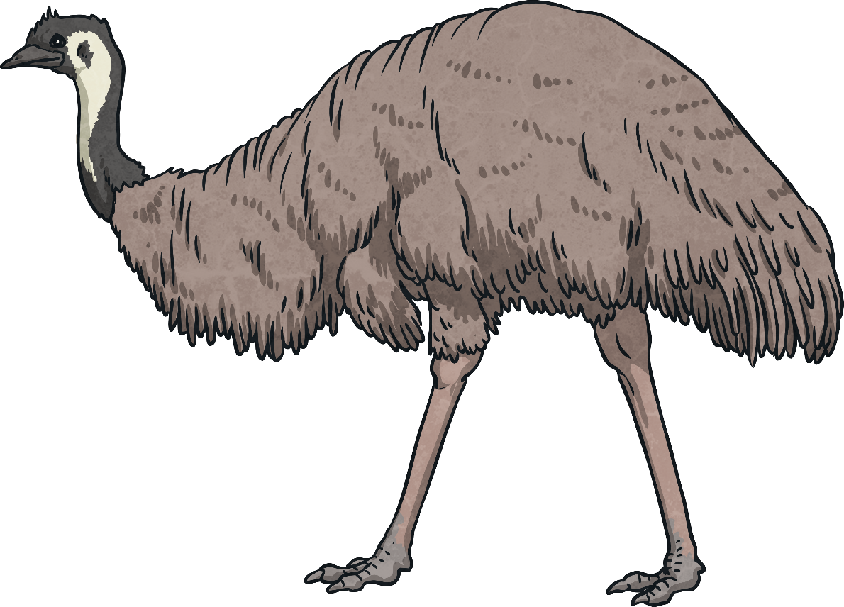
Food Collection
When the Emu in the Sky changes its position to look like it is running or sitting, the Aboriginal Australians know when it is the time to hunt for emus or start collecting their eggs.

Slide 7
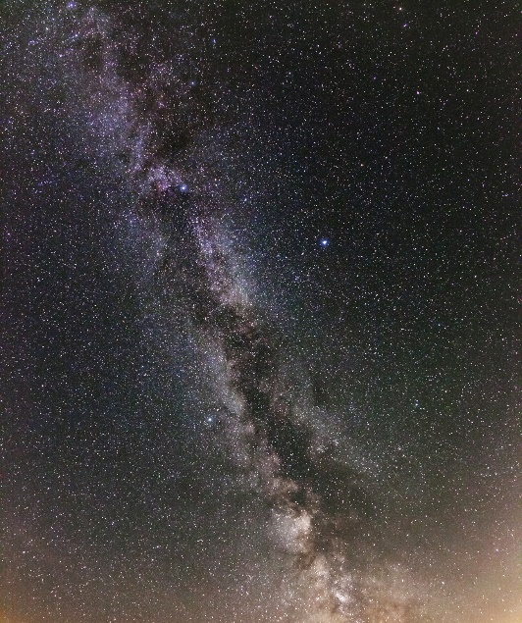
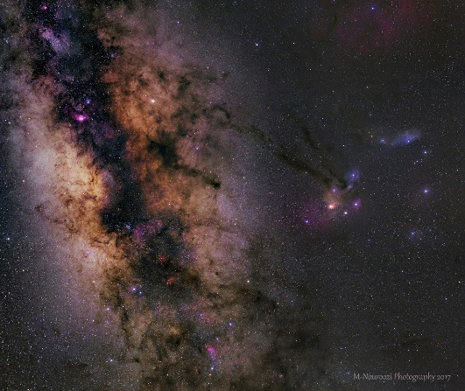
Food Collection
The Boorong people from Victoria look at the Neilloan (mallee fowl or Lyra) constellation to see when the mallee fowl are making their nests and when it is the right time to collect eggs. The birds start to make their nests when the constellation can be seen in the north-west sky. It is time to gather the bird’s eggs when it can no longer be seen.
Photo courtesy (top) of H.Raab (@flickr.com) - granted under creative commons licence
Another aboriginal tribe knows when the wet season is finishing and that dry winds will come soon by looking out for the constellation Scorpius.
Photo courtesy (top) of Jon (@flickr.com) - granted under creative commons licence

Slide 8
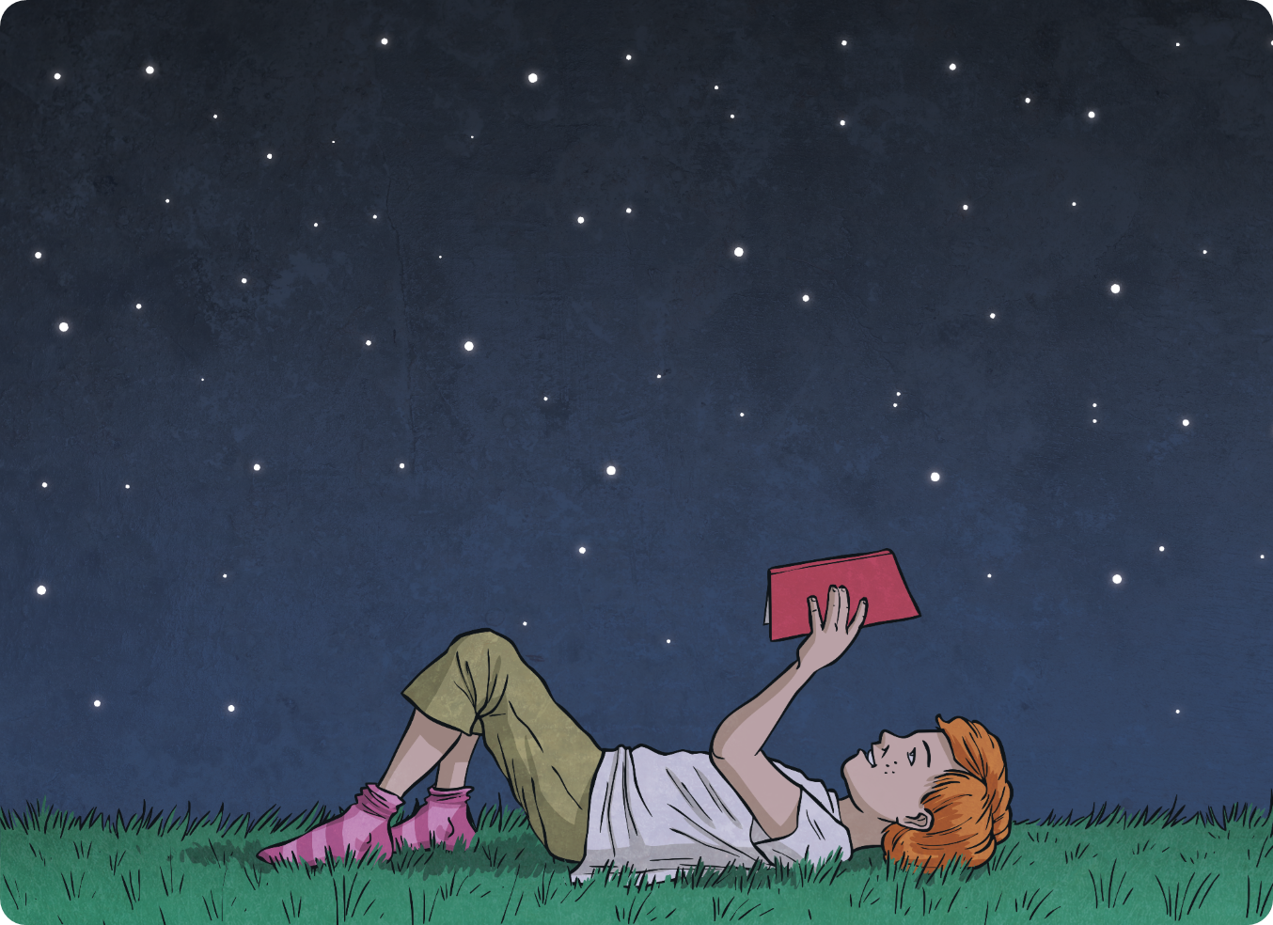
So, a knowledge of the stars and regularly looking at the night sky helps Aboriginal and Torres Strait Islander people with direction, predicting the weather, changes in season and when to start collecting food.
Did you know stars could be so useful?

